Slide 1
Non Parametric Tests : Day_17

Slide 2
Learning Objectives
Recognize the advantages and disadvantages of nonparametric statistics.
Understand how to use the runs test to test for randomness.
Know when and how to use the Mann-Whitney U test, the Wilcoxon matched-pairs signed rank test, the Kruskal-Wallis test, and the Friedman test.
Learn when and how to measure correlation using Spearman’s rank correlation measurement.
Notes:
2

Slide 3
Parametric vs. Nonparametric Statistics
Parametric Statistics are statistical techniques based on assumptions about the population from which the sample data are collected.
Assumption that data being analyzed are randomly selected from a normally distributed population.
Requires quantitative measurement that yield interval or ratio level data.
Nonparametric Statistics are based on fewer assumptions about the population and the parameters.
Sometimes called “distribution-free” statistics.
A variety of nonparametric statistics are available for use with nominal or ordinal data.
Notes:
3

Slide 4
Advantages of Nonparametric Techniques
Sometimes there is no parametric alternative to the use of nonparametric statistics.
Certain nonparametric test can be used to analyze nominal data.
Certain nonparametric test can be used to analyze ordinal data.
The computations on nonparametric statistics are usually less complicated than those for parametric statistics, particularly for small samples.
Probability statements obtained from most nonparametric tests are exact probabilities.
Notes:
4

Slide 5
Disadvantages of Nonparametric Statistics
Nonparametric tests can be wasteful of data if parametric tests are available for use with the data.
Nonparametric tests are usually not as widely available and well know as parametric tests.
For large samples, the calculations for many nonparametric statistics can be tedious.
Notes:
5

Slide 6
Runs Test
Test for randomness - is the order or sequence of observations in a sample random or not
Each sample item possesses one of two possible characteristics
Run - a succession of observations which possess the same characteristic
Example with two runs: F, F, F, F, F, F, F, F, M, M, M, M, M, M, M
Example with fifteen runs: F, M, F, M, F, M, F, M, F, M, F, M, F, M, F

Slide 7
Runs Test: Sample Size Consideration
Sample size: n
Number of sample member possessing the first characteristic: n₁
Number of sample members possessing the second characteristic: n₂
n = n₁ + n₂
If both n₁ and n₂ are  20, the small sample runs test is appropriate.

Slide 8
Runs Test: Small Sample Example
Suppose 26 cola drinkers are sampled randomly to determine whether they prefer regular cola or diet cola. The random sample contains 18 regular cola drinkers and eight diet cola drinkers. Let C denote regular cola drinkers and D denote diet cola drinkers. Suppose the sequence of sampled cola drinkers is CCCCCDCCDCCCCDCDCCCDDDCCC.
Is this sequence of cola drinkers evidence that the sample is not random?

Slide 9
Runs Test: Small Sample Example
H₀: The observations in the sample are randomly generated.
H_{a}: The observations in the sample are not randomly generated.
α = .05
n₁ = 18
n₂ = 8
If 7 ≤ R ≤ 17, do not reject H₀
Otherwise, reject H₀.
1 2 3 4 5 6 7 8 9 10 11 12
D CCCCC D CC D CCCC D C D CCC DDD CCC
R = 12
Since 7 ≤ R = 12 ≤ 17, do not reject H₀

Slide 10
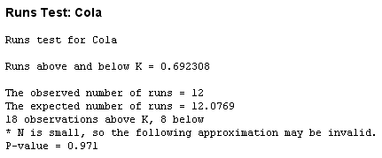
Runs Test: Small Sample Example

Slide 11
Runs Test: Large Sample
Consider the following manufacturing example. A machine produces parts that are occasionally flawed. When the machine is working in adjustment, flaws still occur but seem to happen randomly. A quality-control person randomly selects 50 of the parts produced by the machine today and examines them one at a time in the order that they were made. The result is 40 parts with no flaws and 10 parts with flaws. The sequence of no flaws (denoted by N) and flaws (denoted by F ) is shown on an upcoming slide. Using an alpha of .05, the quality controller tests to determine whether the machine is producing randomly (the flaws are occurring randomly).

Slide 12
Runs Test: Large Sample
If either n₁ or n₂ is > 20, the sampling distribution of R is approximately normal.

Slide 13
Runs Test: Large Sample Example
H₀: The observations in the sample are randomly generated.
H_{a}: The observations in the sample are not randomly generated.
α = .05
n₁ = 40
n₂ = 10
If -1.96 ≤ Z ≤ 1.96, do not reject H₀
Otherwise, reject H₀.
1
1 2 3 4 5 6 7 8 9 0 11
NNN F NNNNNNN F NN FF NNNNNN F NNNN F NNNNN
12 13
FFFF NNNNNNNNNNNN R = 13

Slide 14
Runs Test: Large Sample Example
-1.96 ≤ Z = -1.81 ≤ 1.96,
do not reject H₀

Slide 15
Mann-Whitney U Test
Mann-Whitney U test - a nonparametric counterpart of the t test used to compare the means of two independent populations.
Nonparametric counterpart of the t test for independent samples
Does not require normally distributed populations
May be applied to ordinal data
Assumptions
Independent Samples
At Least Ordinal Data
Notes:
37

Slide 16
Mann-Whitney U Test: Sample Size Consideration
Size of sample one: n₁
Size of sample two: n₂
If both n₁ and n₂ are ≤ 10, the small sample procedure is appropriate.
If either n₁ or n₂ is greater than 10, the large sample procedure is appropriate.

Slide 17
Mann-Whitney U Test: Small Sample Example-Demonstration Problem
Is there a difference between health service workers and educational service workers in the amount of compensation employers pay them per hour? Suppose a random sample of seven health service workers is taken along with a random sample of eight educational service workers from different parts of the country. Each of their employers is interviewed and figures are obtained on the amount paid per hour for employee compensation for these workers.
Use a Mann-Whitney U test to determine whether these two populations are different in employee compensation.

Slide 18
Mann-Whitney U Test: Small Sample Example-Demonstration Problem
H₀: The health service population is identical to the educational service population on employee compensation
H_{a}: The health service population is not identical to the educational service population on employee compensation
Health
Educational
Service
Service
20.10
26.19
19.80
23.88
22.36
25.50
18.75
21.64
21.90
24.85
22.96
25.30
20.75
24.12
23.45

Slide 19
Mann-Whitney U Test: Small Sample Example-Demonstration Problem
Compensation
Rank
Group
α = .05
If the final p-value < .05, reject H₀.
W₁ = 1 + 2 + 3 + 4 + 6 + 7 + 8 = 31
W₂ = 5 + 9 + 10 + 11 + 12 + 13 + 14 + 15 = 89
18.75
1
H
19.80
2
H
20.10
3
H
20.75
4
H
21.64
5
E
21.90
6
H
22.36
7
H
22.96
8
H
23.45
9
E
23.88
10
E
24.12
11
E
24.85
12
E
25.30
13
E
25.50
14
E
26.19
15
E

Slide 20
Mann-Whitney U Test: Small Sample Example
Since U₂ < U₁, U = 3.
p-value = .0011*2
(for a two-tailed test) = .022
< .05, reject H₀.

Slide 21
Mann-Whitney U Test: Formulas for Large Sample Case
Notes:
42

Slide 22
Incomes of PBS and Non-PBS Viewers
The Mann-Whitney U test can be used to determine whether there is a difference in the average income of families who view PBS television and families who do not view PBS television. Suppose a sample of 14 families that have identified themselves as PBS television viewers and a sample of 13 families that have identified themselves as non-PBS television viewers are selected randomly.

Slide 23
Incomes of PBS and Non-PBS Viewers
PBS
Non-PBS
H_{o}: The incomes for PBS viewers and non-PBS viewers are identical
H_{a}: The incomes for PBS viewers and non-PBS viewers are not identical
24,500
41,000
39,400
32,500
36,800
33,000
44,300
21,000
57,960
40,500
n₁ = 14
32,000
32,400
61,000
16,000
n₂ = 13
34,000
21,500
43,500
39,500
55,000
27,600
39,000
43,500
62,500
51,900
61,400
27,800
53,000
Notes:
43

Slide 24
Ranks of Income from Combined Groups of PBS and Non-PBS Viewers
Income
Rank
Group
Income
Rank
Group
16,000
1
Non-PBS
39,500
15
Non-PBS
21,000
2
Non-PBS
40,500
16
Non-PBS
21,500
3
Non-PBS
41,000
17
Non-PBS
24,500
4
PBS
43,000
18
PBS
27,600
5
Non-PBS
43,500
19.5
PBS
27,800
6
Non-PBS
43,500
19.5
Non-PBS
32,000
7
PBS
51,900
21
Non-PBS
32,400
8
Non-PBS
53,000
22
PBS
32,500
9
Non-PBS
55,000
23
PBS
33,000
10
Non-PBS
57,960
24
PBS
34,000
11
PBS
61,000
25
PBS
36,800
12
PBS
61,400
26
PBS
39,000
13
PBS
62,500
27
PBS
39,400
14
PBS
Notes:
44

Slide 25
PBS and Non-PBS Viewers: Calculation of U
Notes:
45

Slide 26
PBS and Non-PBS Viewers: Conclusion
Notes:
46

Slide 27
Wilcoxon Matched-Pairs Signed Rank Test
Mann-Whitney U test is a nonparametric alternative to the t test for two independent samples. If the two samples are related, the U test is not applicable.
Handle related data
Serves as a nonparametric alternative to the t test for two related samples
A nonparametric alternative to the t test for related samples
Before and After studies
Studies in which measures are taken on the same person or object under different conditions
Studies or twins or other relatives
Notes:
47

Slide 28
Wilcoxon Matched-Pairs Signed Rank Test
Differences of the scores of the two matched samples
Differences are ranked, ignoring the sign
Ranks are given the sign of the difference
Positive ranks are summed
Negative ranks are summed
T is the smaller sum of ranks

Slide 29
Wilcoxon Matched-Pairs Signed Rank Test: Sample Size Consideration
n is the number of matched pairs
If n > 15, T is approximately normally distributed, and a Z test is used.
If n ≤ 15, a special “small sample” procedure is followed.
The paired data are randomly selected.
The underlying distributions are symmetric.

Slide 30
Wilcoxon Matched-Pairs Signed Rank Test: Small Sample Example
Consider the survey by American Demographics that estimated the average annual household spending on healthcare. The U.S. metropolitan average was $1,800.
Suppose six families in Pittsburgh, Pennsylvania, are matched demographically with six families in Oakland, California, and their amounts of household spending on healthcare for last year are obtained.

Slide 31
Wilcoxon Matched-Pairs Signed Rank Test: Small Sample Example
H₀: M_{d} = 0
H_{a}: M_{d} ≠ 0
n = 6
α =0.05
If T_{observed} ≤ 1, reject H_{0.}
Family
Pair
Pittsburgh
Oakland
1
1,950
1,760
2
1,840
1,870
3
2,015
1,810
4
1,580
1,660
5
1,790
1,340
6
1,925
1,765

Slide 32
Wilcoxon Matched-Pairs Signed Rank Test: Small Sample Example
Family
Pair
Pittsburgh
Oakland
d
Rank
1
1,950
1,760
190
+4
2
1,840
1,870
-30
-1
3
2,015
1,810
205
+5
4
1,580
1,660
-80
-2
5
1,790
1,340
450
+6
6
1,925
1,765
160
+3
T = minimum(T₊, T₋)
T₊ = 4 + 5 + 6 + 3= 18
T₋ = 1 + 2 = 3
T = 3
T = 3 > T_{crit} = 1, do not reject H₀.

Slide 33
Wilcoxon Matched-Pairs Signed Rank Test: Large Sample Formulas
For large samples, the T statistic is approximately normally distributed and a z score can be used as the test statistic. This technique can be applied to the airline industry, where an analyst might want to determine whether there is a difference in the cost per mile of airfares in the United States between 1979 and 2011 for various cities.
The data in Table 17.3 represent the costs per mile of airline tickets for a sample of 17 cities for both 1979 and 2011.

Slide 34
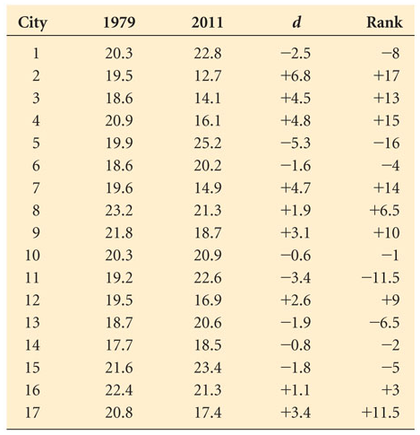
Wilcoxon Matched-Pairs Signed Rank Test: Large Sample Formulas

Slide 35
Wilcoxon Matched-Pairs Signed Rank Test: Large Sample Formulas
Notes:
52

Slide 36
Airline Cost Data for 17 Cities, 1979 and 2009
H₀: M_{d} = 0
H_{a}: M_{d} ≠ 0
City
1979
2011
d
Rank
City
1979
2011
d
Rank
1
20.3
22.8
-2.5
-8
10
20.3
20.9
-0.6
-1
2
19.5
12.7
6.8
17
11
19.2
22.6
-3.4
-11.5
3
18.6
14.1
4.5
13
12
19.5
16.9
2.6
9
4
20.9
16.1
4.8
15
13
18.7
20.6
-1.9
-6.5
5
19.9
25.2
-5.3
-16
14
17.7
18.5
-0.8
-2
6
18.6
20.2
-1.6
-4
15
21.6
23.4
-1.8
-5
7
19.6
14.9
4.7
14
16
22.4
21.3
1.1
3
8
23.2
21.3
1.9
6.5
17
20.8
17.4
3.4
11.5
9
21.8
18.7
3.1
10
Notes:
53

Slide 37
Airline Cost: T Calculation
Notes:
54

Slide 38
Airline Cost: Conclusion
Notes:
55

Slide 39
Kruskal-Wallis Test
Kruskal-Wallis Test - A nonparametric alternative to one-way analysis of variance
May used to analyze ordinal data
No assumed population shape
Assumes that the C groups are independent
Assumes random selection of individual items
Notes:
56

Slide 40
Kruskal-Wallis K Statistic
Notes:
57

Slide 41
Number of Patients per Day per Physician in Three Organizational Categories
Suppose a researcher wants to determine whether the number of physicians in an office produces significant differences in the number of office patients seen by each physician per day.
She takes a random sample of physicians from practices in which (1) there are only two partners, (2) there are three or more partners, or (3) the office is a health maintenance organization (HMO).

Slide 42
Number of Patients per Day per Physician in Three Organizational Categories
H_{o}: The three populations are identical
H_{a}: At least one of the three populations is different
Three or
Two
More
Partners
Partners
HMO
13
24
26
15
16
22
20
19
31
18
22
27
23
25
28
14
33
17
Notes:
58

Slide 43

Patients per Day Data: Kruskal-Wallis Preliminary Calculations
Three or
Two
More
Partners
Partners
HMO
Patients
Rank
Patients
Rank
Patients
Rank
13
1
24
12
26
14
15
3
16
4
22
9.5
20
8
19
7
31
17
18
6
22
9.5
27
15
23
11
25
13
28
16
14
2
33
18
17
5
T₁ = 29
T₂ = 52.5
T₃ = 89.5
n₁ = 5
n₂ = 7
n₃ = 6
n = n₁ + n₂ + n₃ = 5 + 7 + 6 = 18
Notes:
59

Slide 44
Patients per Day Data: Kruskal-Wallis Calculations and Conclusion
Notes:
60

Slide 45
Friedman Test
Friedman Test - A nonparametric alternative to the randomized block design
Assumptions
The blocks are independent.
There is no interaction between blocks and treatments.
Observations within each block can be ranked.
Hypotheses
H_{o}: The treatment populations are equal
H_{a}: At least one treatment population yields larger values than at least one other treatment population

Slide 46
Friedman Test

Slide 47
Friedman Test: Tensile Strength of Plastic Housings
A manufacturing company assembles microcircuits that contain a plastic housing. Managers are concerned about an unacceptably high number of the products that sustained housing damage during shipment. The housing component is made by four different suppliers.
Managers have decided to conduct a study of the plastic housing by randomly selecting five housings made by each of the four suppliers.
One housing is selected for each day of the week. That is, for each supplier, a housing made on Monday is selected, one made on Tuesday is selected, and so on.
In analyzing the data, the treatment variable is supplier and the treatment levels are the four suppliers. The blocking effect is day of the week with each day representing a block level. The quality control team wants to determine whether there is any significant difference in the tensile strength of the plastic housing by supplier.

Slide 48
Friedman Test: Tensile Strength of Plastic Housings
H_{o}: The supplier populations are equal
H_{a}: At least one supplier population yields larger values than at least one other supplier population
Supplier 1
Supplier 2
Supplier 3
Supplier 4
Monday
62
63
57
61
Tuesday
63
61
59
65
Wednesday
61
62
56
63
Thursday
62
60
57
64
Friday
64
63
58
66

Slide 49
Friedman Test: Tensile Strength of Plastic Housings

Slide 50
Friedman Test: Tensile Strength of Plastic Housings
Supplier 1
Supplier 2
Supplier 3
Supplier 4
Monday
3
4
1
2
Tuesday
3
2
1
4
Wednesday
2
3
1
4
Thursday
3
2
1
4
Friday
3
2
1
4
R
14
13
5
18
j
R
2
196
169
25
324
j

Slide 51
Friedman Test: Tensile Strength of Plastic Housings

Slide 52
Spearman’s Rank Correlation
Spearman’s Rank Correlation - Analyze the degree of association of two variables
Applicable to ordinal level data (ranks)
Notes:
67

Slide 53
Spearman’s Rank Correlation
Listed below are the average prices in dollars per 100 pounds for choice spring lambs and choice heifers over a 10-year period. The data were published by the National Agricultural Statistics Service of the U.S. Department of Agriculture.
Suppose the researcher want to determine the strength of association of the prices between these two commodities by using Spearman’s rank correlation.

Slide 54
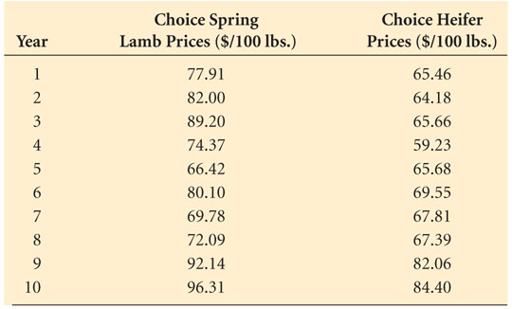
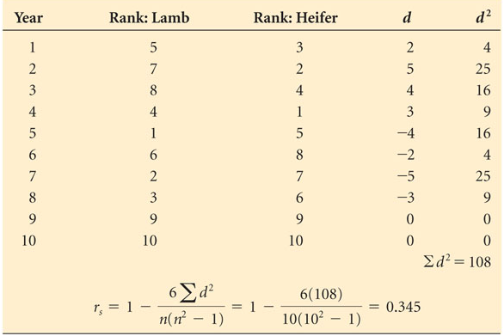
Spearman’s Rank Correlation for Heifer and Lamb Prices

Slide 55
Spearman’s Rank Correlation for Heifer and Lamb Prices
Notes:
67

Slide 56
Spearman’s Rank Correlation for Heifer and Lamb Prices
The lamb prices are ranked and the heifer prices are ranked.
The difference in ranks is computed for each year.
The differences are squared and summed, producing ∑d² = 108.
The number of pairs, n, is 10.
The value of r_{s} = 0.345 indicates that there is a very modest if not poor positive correlation between lamb and heifer prices.

